Slide 1
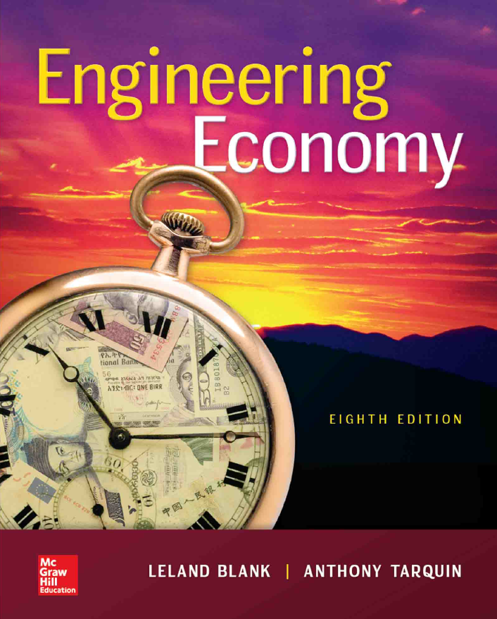

Chapter 8
Rate of Return Multiple Alternatives
Lecture slides to accompany
Engineering Economy
8th edition
Leland Blank
Anthony Tarquin
8-<number>

Slide 2
LEARNING OUTCOMES
Why incremental analysis is required in ROR
Incremental cash flow (CF) calculation
Interpretation of ROR on incremental CF
Select alternative by ROR based on PW relation
Select alternative by ROR based on AW relation
Select best from several alternatives using ROR method
8-<number>

Slide 3
Why Incremental Analysis is Necessary
Selecting the alternative with _______ ROR may ____
yield _______ return on available capital
Must consider __________ average of total capital available
Capital not invested in a project is assumed to earn at ____
Example: Assume $90,000 is available for investment and MARR = 16%
per year. If alternative A would earn 35% per year on investment of $50,000, and
B would earn 29% per year on investment of $85,000, the weighted averages are:
Overall ROR_{A} = [50,000(0.35) + 40,000(0.16)]/90,000 = 26.6%
Overall ROR_{B} = [85,000(0.29) + 5,000(0.16)]/90,000 = 28.3%
Which investment is better, economically?
8-<number>

Slide 4
Why Incremental Analysis is Necessary
If selection basis is higher ROR:
Select alternative A ( ______ answer)
If selection basis is higher _______ ROR:
Select alternative B
Conclusion: Must use an _________ ROR analysis to make a consistently correct selection
Unlike PW, AW, and FW values, if not analyzed correctly, ROR values can lead to an incorrect alternative selection. This is called the ranking _____________ problem (discussed later)
8-<number>

Slide 5
Calculation of Incremental CF
___________ cash flow = cash flow_{B} – cash flow_{A}
where ______ initial investment is Alternative B
Example: Either of the cost alternatives shown below can be used in
a grinding process. Tabulate the incremental cash flows.
A
B
B - A
First cost, $ -40,000 - 60,000
-20,000
Annual cost, $/year -25,000 -19,000
+6000
Salvage value, $ 8,000 10,000
+2000
The incremental CF is shown in the (B-A) column
The ROR on the _______ $20,000 investment in B determines which alternative
to select (as discussed later)
8-<number>

Slide 6

Interpretation of ROR on Extra Investment
Based on concept that any _________ investment that
does not yield at least the MARR should ___ be made.
Once a lower-cost alternative has been economically justified, the ROR on the _____ investment (i.e., additional amount of money associated with a higher first-cost alternative) must also yield a ROR < MARR (because the extra investment is _________ by selecting the economically-justified lower-cost alternative).
This incremental ROR is identified as ____
For ___________ projects, select all that have ROR ≥ MARR (___ incremental analysis is necessary)
8-<number>

Slide 7

ROR Evaluation for Two ME Alternatives
Order alternatives by __________ initial investment cost
(2) Develop incremental CF series using LCM of years
(3) Draw incremental cash flow diagram, if needed
(4) Count sign changes to see if multiple ∆i* values exist
(5) Set up PW, AW, or FW = 0 relation and find ∆i*_{B-A}
Note: Incremental ROR analysis requires ______________ comparison. The LCM of lives must be used in the relation
(6) If ∆i*_{B-A} < MARR, select __; otherwise, select __
If multiple ∆i* values exist, find EROR using either
MIRR or ROIC approach.
8-<number>

Slide 8
Example: Incremental ROR Evaluation
Either of the cost alternatives shown below can be used in a
chemical refining process. If the company’s MARR is 15% per year,
determine which should be selected on the basis of ROR analysis?
A
B
First cost ,$ -40,000 -60,000
Annual cost, $/year -25,000 -19,000
Salvage value, $ 8,000 10,000
Life, years 5 5
Initial observations: ME, cost alternatives with equal life estimates
and no multiple ROR values indicated
8-<number>

Slide 9
Example: ROR Evaluation of Two Alternatives
Solution, using procedure:
A
B
B - A
First cost , $ -40,000 -60,000
-20,000
Annual cost, $/year -25,000 -19,000
+6000
Salvage value, $ 8,000 10,000
+2000
Life, years 5 5
Order by ____ cost and find __________ cash flow B - A
Write ROR equation (in terms of PW, AW, or FW) on incremental CF
0 = -20,000 + 6000(P/A,∆i*,5) + 2000(P/F,∆i*,5)
Solve for ∆i* and compare to MARR
∆i*_{B-A} = 17.2% > MARR of 15%
ROR on $20,000 extra investment is acceptable: Select ___
8-<number>

Slide 10
ROR Analysis – Multiple Alternatives
Six-Step Procedure for Mutually ( ) Alternatives
(1) Order alternatives from ____________ to largest initial investment
(2) For revenue alts, calculate i* (vs. DN) and ________ all with i* < MARR; remaining
alternative with lowest cost is defender. For cost alternatives, go to step (3)
(3) Determine incremental CF between defender and next lowest-cost alternative
(known as the challenger). Set up ROR relation
(4) Calculate ∆i* on incremental CF between two alternatives from step (3)
(5) If ∆i* ≥ MARR, eliminate ________ and challenger becomes new defender
against next alternative on list
(6) Repeat steps (3) through (5) until only ____ alternative remains. Select it.
For Independent Projects
Compare each alternative vs. DN and select all with ROR ≥ MARR
8-<number>

Slide 11
Example: ROR for Multiple Alternatives
The five mutually exclusive alternatives shown below are under consideration for improving visitor safety and access to additional areas of a national park. If all alternatives are considered to last indefinitely, determine which should be selected on the basis of a rate of return analysis using an interest rate of 10%.
A B C D E_
First cost, $ millions -20 -40 -35 -90 -70
Annual M&O cost, $ millions -2 -1.5 -1.9 -1.1 -1.3
Solution:
Rank on the basis of initial cost: A,C,B,E,D; calculate CC values
C vs. A: 0 = -15 + 0.1/∆i* ∆i* = 6.7% (eliminate C)
B vs. A: 0 = -20 + 0.5/∆i* ∆i* = 25% (eliminate A)
E vs. B: 0 = -30 + 0.2/∆i* ∆i* = 6.7% (eliminate E)
D vs. B: 0 = -50 + 0.4/∆i* ∆i* = 8% (eliminate D)
Select alternative ____
8-<number>

Slide 12
Summary of Important Points
Must consider ___________ cash flows for ________ ________alternatives
Incremental cash flow = cash flow_{B} – cash flow_{A}
where alternative with ________ initial investment is Alternative B
Eliminate __ if incremental ROR ∆i* < MARR; otherwise, eliminate __
For multiple mutually exclusive alternatives, compare two at a time
and eliminate alternatives until only ____ remains
For independent alternatives, compare each against DN and select
____ that have ROR ≥ MARR
8-<number>

Slide 13
HOMEWORK
Please solve every Examples in your textbook. You do not have to submit your works.
Please upload following “PROBLEMS” solution file on “Assignment” menu in e-Class.
  8.17
  8.23
  8.34
  8.39
  8.57
4-<number>

